Slide 1
Stock Volatility Forecasting and Word Features Selection —— Based On 10-K Corpus
Wang Zeyu
Liu Chang
Tan Huangao
Li Borui
Zhu Xinqi
Gao Yifeng

Slide 2
Contents
Ⅰ Introduction
Ⅱ Methods
Ⅲ Result
Ⅳ Conclusion

Slide 3
Ⅰ Introduction

Slide 4
Introduction- Goals
Our project aims to:
1. Predict the log volatility of the following year via the MD&A section of the Form 10-K;
2. Find out the importance of each token and check whether they are similar over the years.
Notes:
Openneuro: A free and open platform for validating and sharing BIDS-compliant MRI, PET, MEG, EEG, and iEEG data

Slide 5
Introduction- Motivation
These two goals are meaningful because:
1. The MD&A section is most related to the forecasting in Form 10-K;
2. A better predicting model can lead to a better portfolio;
3. Such models show the market information transmission mechanisms.
Notes:
Openneuro: A free and open platform for validating and sharing BIDS-compliant MRI, PET, MEG, EEG, and iEEG data

Slide 6
Introduction- Dataset
We use a portion of the data in 10-K Corpus^{[1]}, including:
1. The tokenized MD&A sections;
- (e.g. 1996.tok.tgz)
2. The log volatility in the related year.
- (e.g. 1996.logvol.-12.txt, 1996.logvol.+12.txt)
[1] Shimon Kogan et al. (2009). “Predicting risk from financial reports with regression”. In: Proceedings of human language technologies: the 2009 annual conference of the North American Chapter of the Association for Computational Linguistics, pp. 272–280.
Notes:
Openneuro: A free and open platform for validating and sharing BIDS-compliant MRI, PET, MEG, EEG, and iEEG data

Slide 7
Ⅱ Methods

Slide 8
Methods - Lemmatization, Stemming and Stop token filter
We use the Natural Language Toolkit (NLTK)^{[2]} as lemmatizer, stemmer and stop token filter.
1. Some words are regarded as insignificant in text analysis;
- (e.g. a, an, the, above, across)
2. Words appear in several inflected forms but with same meaning should be considered as the same;
- (e.g. achieves, achieved, achievement, achievements → achiev)
[2] Bird et al. (2009). Natural Language Processing with Python. O’Reilly Media Inc.

Slide 9
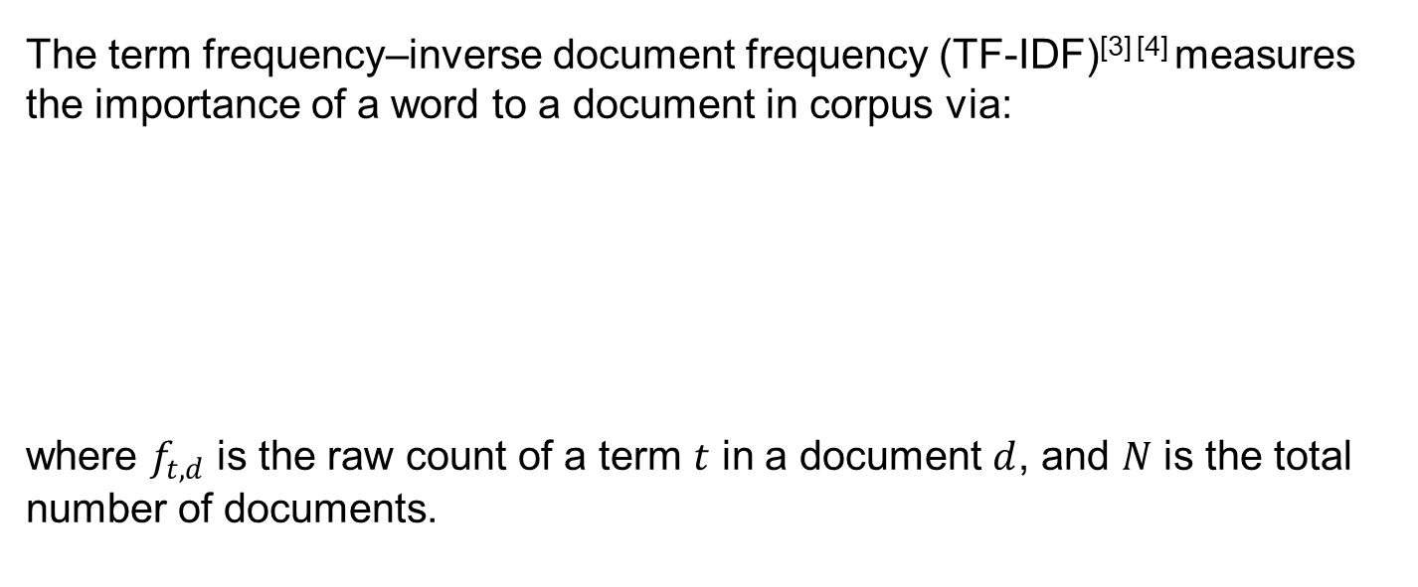
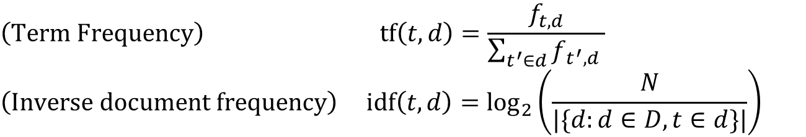
Methods - Term Frequency–Inverse Document Frequency (TF-IDF)
The term frequency–inverse document frequency (TF-IDF)^{[3] [4]} measures the importance of a word to a document in corpus via:
where $f_{t,d}$ is the raw count of a term $t$ in a document $d$, and $N$ is the total number of documents.
$$\left(\text{Term} \text{Frequency}\right) \text{tf}\left(t, d\right)=\frac{f_{t, d}}{\sum_{t^{′}∈d}{f_{t^{′}, d}} }$$
$$\left(\text{Inverse} \text{document} \text{frequency}\right) \text{idf}\left(t, d\right)=\log_{2}\left(\frac{N}{|\{d:d∈D, t∈d\}|}\right)$$
[3] Karen Sparck Jones (1972). “A statistical interpretation of term specificity and its application in retrieval”. In: Journal of documentation 28.1, pp. 11–21.
[4] Stephen Robertson (2004). “Understanding inverse document frequency: on theoretical arguments for IDF”. In: Journal of documentation 60.5, pp. 503–520.

Slide 10
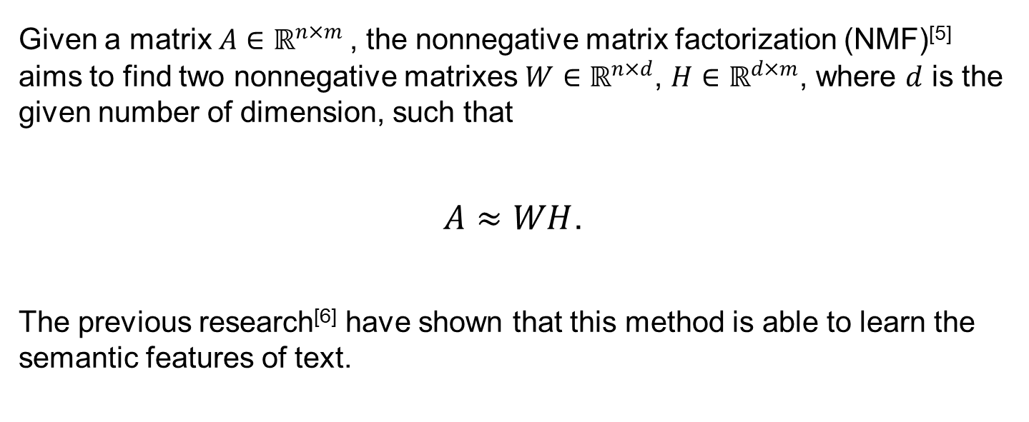
Methods - Nonnegative Matrix Factorization (NMF)
Given a matrix $A∈ℝ^{n×m}$, the nonnegative matrix factorization (NMF)^{[5]} aims to find two nonnegative matrixes $W∈ℝ^{n×d}$, $H∈ℝ^{d×m}$, where $d$ is the given number of dimension, such that
$A≈WH$.
The previous research^{[6]} have shown that this method is able to learn the semantic features of text.
[5] Daniel Lee and H Sebastian Seung (2000). “Algorithms for non-negative matrix factorization”. In: Advances in neural information processing systems 13.
[6] Daniel D Lee and H Sebastian Seung (1999). “Learning the parts of objects by non-negative matrix factorization”. In: nature 401.6755, pp. 788–791.

Slide 11
Methods - Naive Model (Baseline)
1. The naive model (or Persistence model) uses the current (or same period) value as the forecast;
2. The previous research^{[7]} has shown that the naive model is better than many other complex models, especially for high-volatility time series;
3. It doesn’t involve the word features or any assumptions.
[7] Nico Beck, Jonas Dovern, and Stefanie Vogl (2025). “Mind the naive forecast! a rigorous evaluation of forecasting models for time series with low predictability”. In: Applied Intelligence 55.6, p. 395.

Slide 12
Methods - Lasso/Ridge Regression & Decision Tree
1. These models (also their extensions) are powerful in forecast and can have better performance compare with other models like heterogeneous autoregressive (HAR) models^{[8] [9] [10]} ;
2. These models are inherently interpretable, which can help us extract whether a word implies the increasing or decreasing of volatility.
[8] Chao Liang et al. (2023). “Forecasting China’s stock market volatility with shrinkage method: Can Adaptive Lasso select stronger predictors from numerous predictors?” In: International Journal of Finance & Economics 28.4, pp. 3689–3699.
[9] Xiafei Li, Chao Liang, and Feng Ma (2022). “Forecasting stock market volatility with a large number of predictors: New evidence from the MS-MIDAS-LASSO model”. In: Annals of Operations Research, pp. 1–40.
[10] Kim Christensen, Mathias Siggaard, and Bezirgen Veliyev (2023). “A machine learning approach to volatility forecasting”. In: Journal of Financial Econometrics 21.5, pp. 1680–1727.

Slide 13

Methods - Evaluation
We use mean absolute error and mean squared error to evaluate the results:
$$\text{MAE}\left(x, \hat{x}\right)=\frac{1}{N}\sum_{i=1}^{N}{\left|x_{i}−{\hat{x}}_{i}\right|},$$
$$\text{MSE}\left(x, \hat{x}\right)=\frac{1}{N}\sum_{i=1}^{N}{{\left(x_{i}−{\hat{x}}_{i}\right)}^{2}.}$$

Slide 14
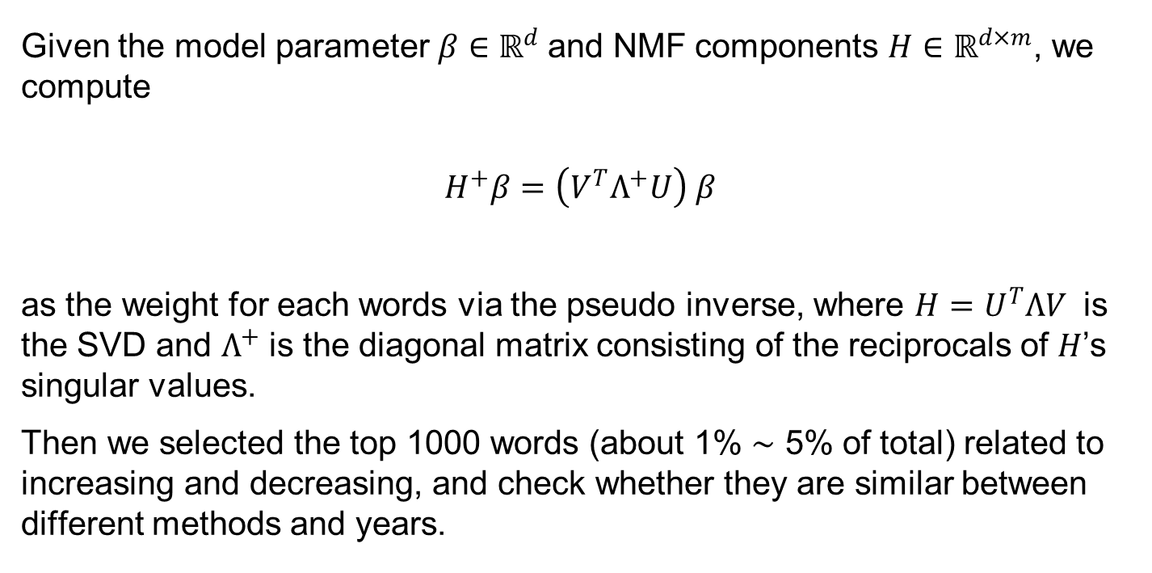
Methods – Feature Selection
Given the model parameter $β∈ℝ^{d}$and NMF components $H∈ℝ^{d×m}$, we compute
$$H^{+}β=\left(V^{T}Λ^{+}U\right) β$$
as the weight for each words via the pseudo inverse, where $H=U^{T}ΛV$ is the SVD and $Λ^{+}$ is the diagonal matrix consisting of the reciprocals of $H$’s singular values.
Then we selected the top 1000 words (about 1% ∼ 5% of total) related to increasing and decreasing, and check whether they are similar between different methods and years.

Slide 15
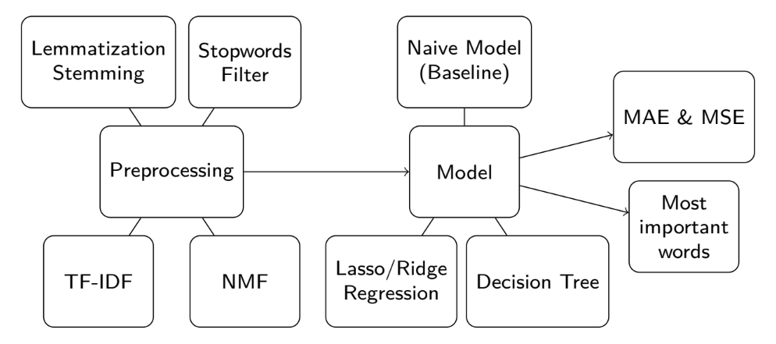
Methods - Overview
We test the model in two approaches:
1. Split the data from some years into training dataset (80%) and test dataset (20%), and repeat the experiment to avoid flukes;
2. Train the model via the data from some years and forecast the following year.

Slide 16
Ⅲ Result

Slide 17
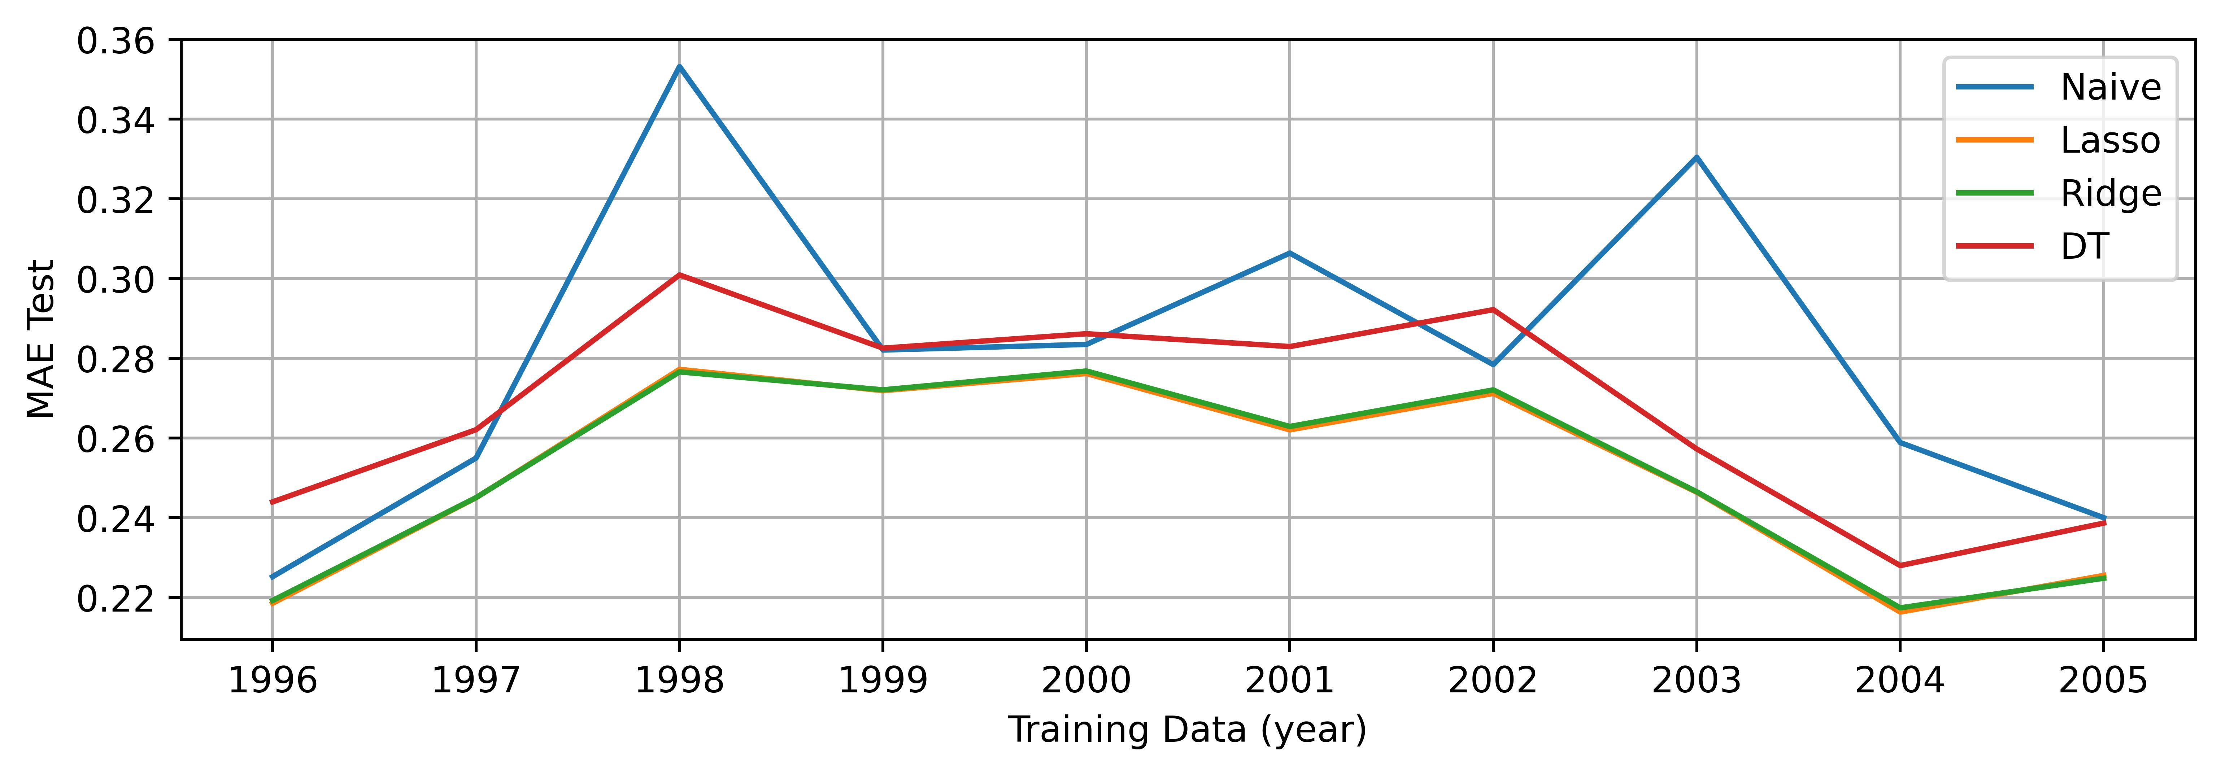
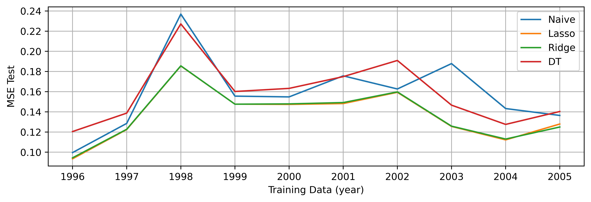
Result - Error
Figure: MAE and MSE for testing 1-year training set.

Slide 18
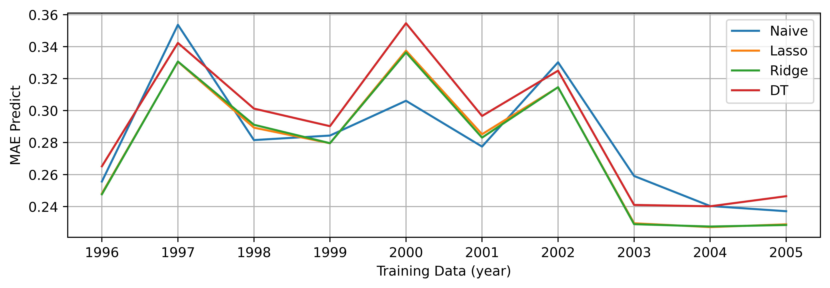
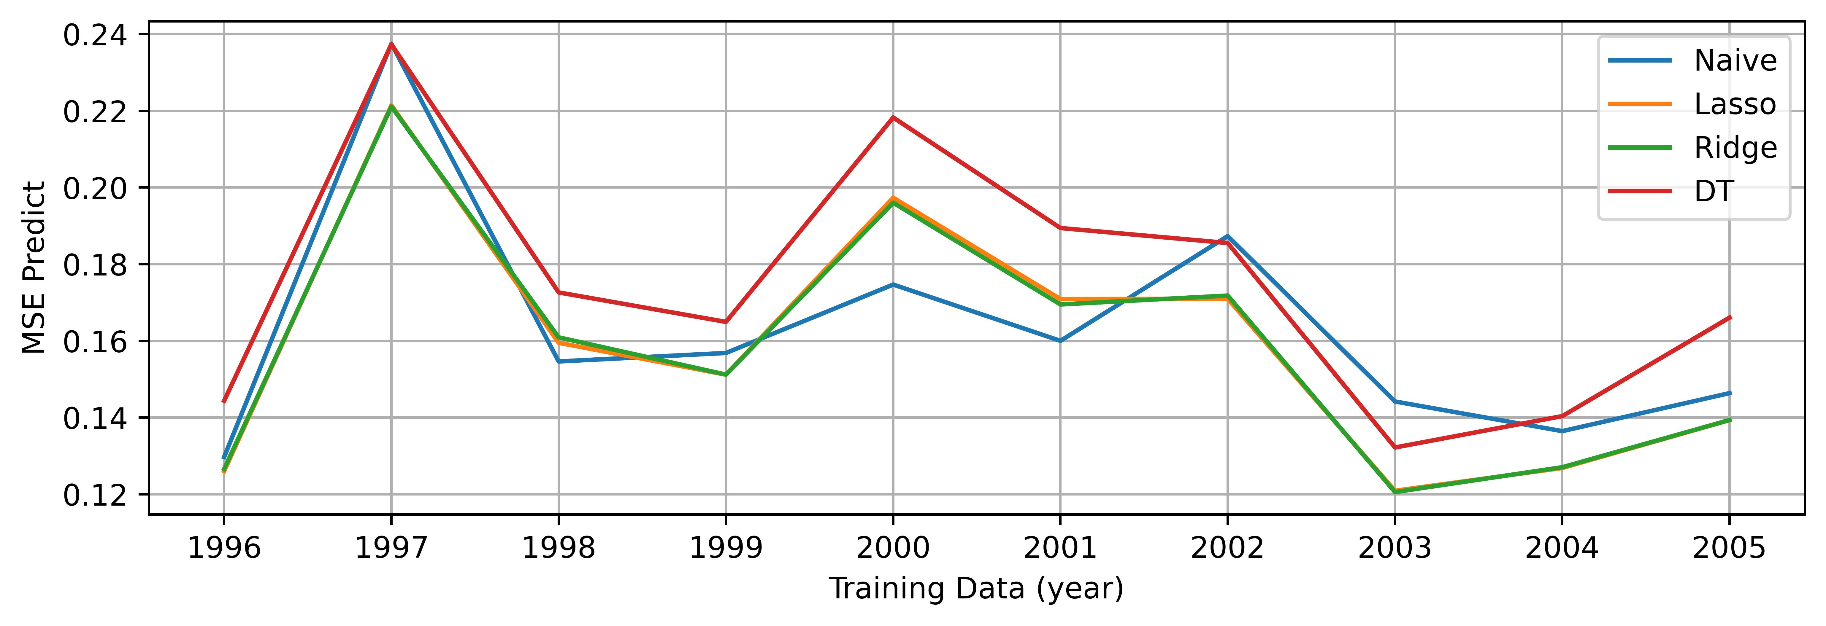
Result - Error
Figure: MAE and MSE for predicting 1-year training set.

Slide 19
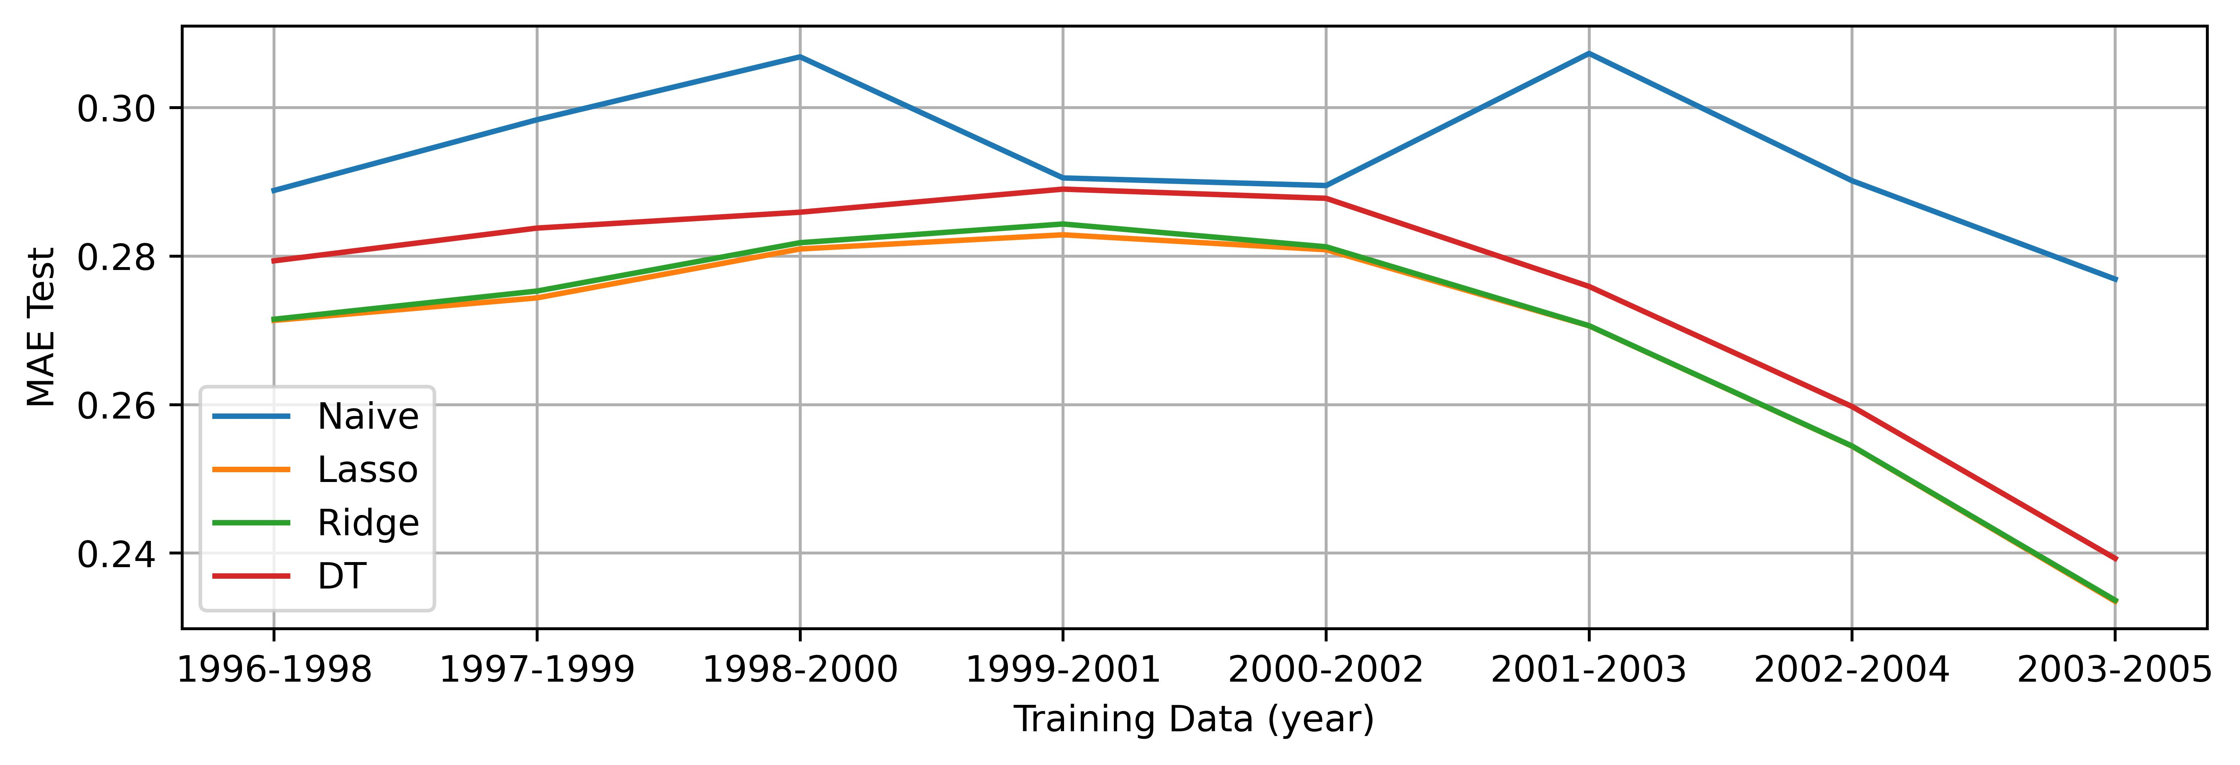
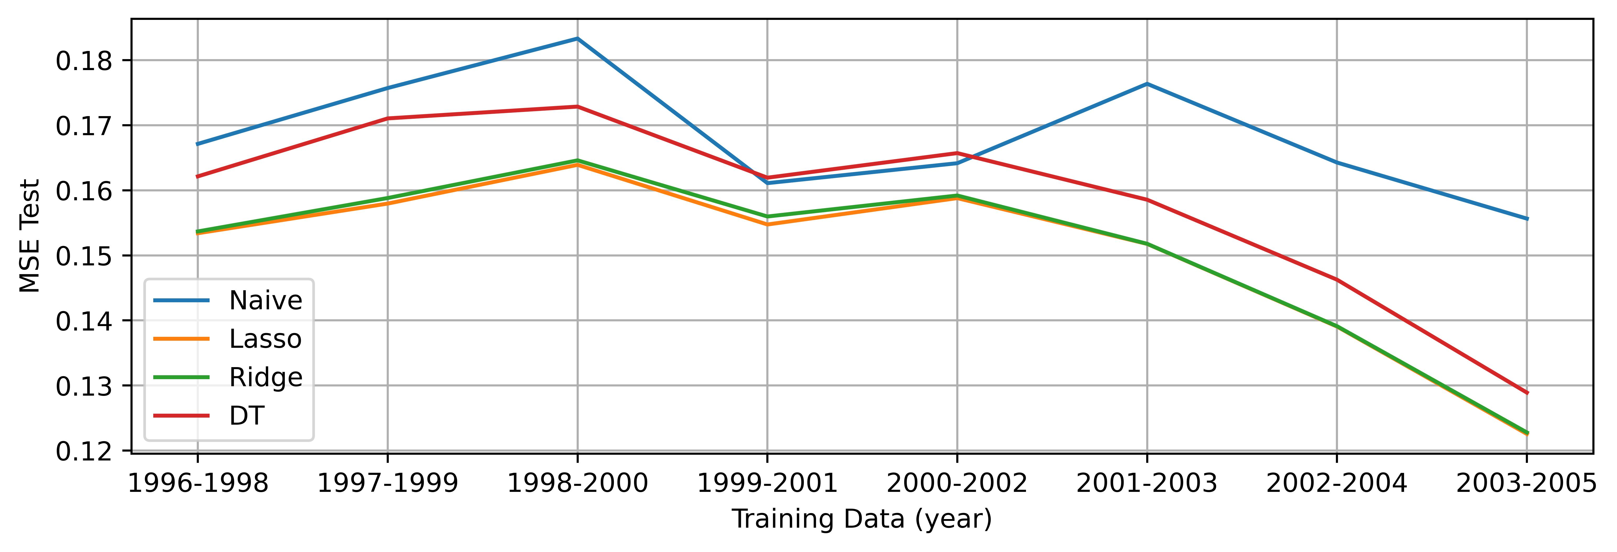
Result - Error
Figure: MAE and MSE for testing 3-year training set.

Slide 20
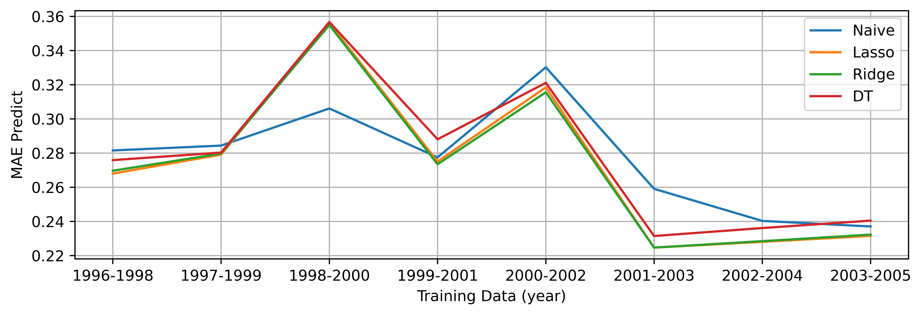
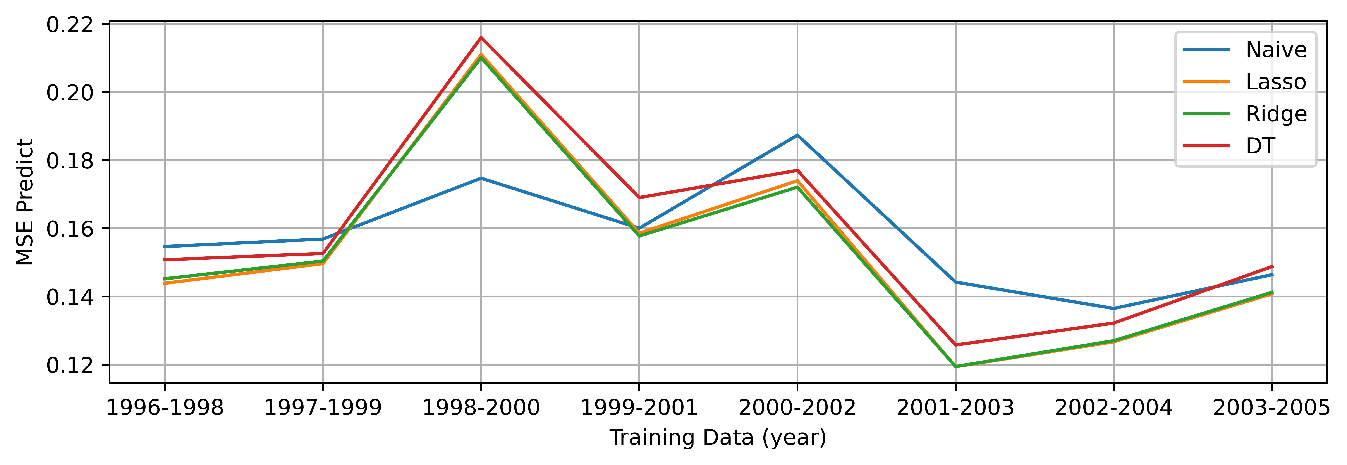
Result - Error
Figure: MAE and MSE for predicting 3-year training set.

Slide 21
Result - Word Features
Year | Increasing Common | Decreasing Common | Different
1996-1997 | 53.9% | 60.6% | 1.9%
1997-1998 | 35.1% | 39.2% | 6.4%
1998-1999 | 23.6% | 31.7% | 5.6%
1999-2000 | 3.8% | 27.8% | 17.1%
2000-2001 | 5.1% | 24.9% | 1.2%
2001-2002 | 38.0% | 30.4% | 1.2%
2002-2003 | 31.7% | 31.0% | 12.15%
2003-2004 | 26.2% | 58.3% | 3.15%
2004-2005 | 42.2% | 38.3% | 6.4%
Table: Word features for lasso regression between different years.

Slide 22
Result - Word Features
Year | Increasing Common | Decreasing Common | Different
1996-1997 | 48.3% | 55.1% | 2.9%
1997-1998 | 38.1% | 36.9% | 7.55%
1998-1999 | 20.2% | 32.1% | 8.35%
1999-2000 | 9.9% | 38.6% | 6.55%
2000-2001 | 13.2% | 18.9% | 3.25%
2001-2002 | 42.2% | 35.7% | 4.15%
2002-2003 | 35.8% | 36.4% | 9.2%
2003-2004 | 27.3% | 44.6% | 1.25%
2004-2005 | 45.5% | 43.6% | 9.3%
Table: Word features for ridge regression between different years.

Slide 23
Result - Word Features
Year | Increasing Common | Decreasing Common | Different
1996-1997 | 62.7% | 15.8% | 3.6%
1997-1998 | 46.2% | 29.4% | 6.75%
1998-1999 | 37.1% | 18.8% | 8.4%
1999-2000 | 29.3% | 33.2% | 4.4%
2000-2001 | 23.9% | 32.7% | 6.2%
2001-2002 | 23.7% | 3.6% | 10.9%
2002-2003 | 45.7% | 5.8% | 4.3%
2003-2004 | 34.7% | 2.0% | 11.85%
2004-2005 | 56.7% | 7.3% | 2.1%
Table: Word features for decision tree between different years.

Slide 24
Result - Word Features
Year | Lasso Ridge | Lasso DecisionTree | Ridge DecisionTree
1996 | 75.2%/71.6%/0.15% | 23.2%/7.7%/27.0% | 36.1%/25.1%/17.35%
1997 | 82.0%/87.2%/0.15% | 15.4%/7.3%/25.85% | 16.6%/12.2%/25.6%
1998 | 84.4%/85.5%/0.2% | 14.1%/15.1%/15.4% | 12.2%/15.6%/18.6%
1999 | 67.9%/83.9%/0.35% | 17.8%/23.8%/19.8% | 11.5%/23.1%/24.0%
2000 | 68.1%/55.3%/1.85% | 19.0%/25.1%/17.6% | 24.1%/9.5%/26.1%
2001 | 91.7%/92.9%/0.1% | 5.5%/0.9%/31.55% | 6.8%/1.6%/30.55%
2002 | 88.6%/79.1%/0.1% | 37.7%/49.8%/9.75% | 33.8%/39.2%/14.35%
2003 | 93.6%/89.5%/0.15% | 13.4%/10.4%/27.05% | 15.2%/13.9%/25.45%
2004 | 75.2%/73.4%/0.2% | 23.5%/24.2%/21.25% | 30.4%/20.4%/20.85%
2005 | 95.6%/90.8%/0.4% | 9.9%/2.5%/27.5% | 10.2%/5.2%/28.7%
Table: Word features between different models.

Slide 25
Ⅳ Conclusion

Slide 26
Conclusion
Some conclusions are similar to the previous research^{[11]}:
1. More training data can lead to higher accuracy and stability;
2. The Sarbanes–Oxley Act (2002) changes the information and distribution of the words;
3. The Sarbanes–Oxley Act (2002) makes a higher accuracy in
prediction.
[11] Shimon Kogan et al. (2009). “Predicting risk from financial reports with regression”. In: Proceedings of human language technologies: the 2009 annual conference of the North American Chapter of the Association for Computational Linguistics, pp. 272–280.

Slide 27
Conclusion
For the words features:
1. There exists the similarity between different years;
2. The lasso and ridge regression always give the same features, while the decision tree chooses the different (because the decision tree is more likely to split the data based on the previous volatility);
3. The abnormal during 1999 to 2001 may caused by the dot-com bubble;
4. Compare with the features of increasing, the features of decreasing are more similar between years.

Slide 28
Reference I
Beck, Nico, Jonas Dovern, and Stefanie Vogl (2025). "Mind the naive forecast! a rigorous evaluation of forecasting models for time series with low predictability". In: Applied Intelligence 55.6, p. 395.
Bird et al. (2009). Natural Language Processing with Python. O’Reilly Media Inc.
Christensen, Kim, Mathias Siggaard, and Bezirgen Veliyev (2023). "A machine learning approach to volatility forecasting". In: Journal of Financial Econometrics 21.5, pp. 1680–1727.
Kogan, Shimon et al. (2009). "Predicting risk from financial reports with regression". In: Proceedings of human language technologies: the 2009 annual conference of the North American Chapter of the Association for Computational Linguistics, pp. 272–280.

Slide 29
Reference II
Lee, Daniel and H Sebastian Seung (2000). "Algorithms for non-negative matrix factorization". In: Advances in neural information processing systems 13.
Lee, Daniel D and H Sebastian Seung (1999). "Learning the parts of objects by non-negative matrix factorization". In: nature 401.6755, pp. 788–791.
Li, Xiafei, Chao Liang, and Feng Ma (2022). "Forecasting stock market volatility with a large number of predictors: New evidence from the MS-MIDAS-LASSO model". In: Annals of Operations Research, pp. 1–40.

Slide 30
Reference III
Liang, Chao et al. (2023). "Forecasting China’s stock market volatility with shrinkage method: Can Adaptive Lasso select stronger predictors from numerous predictors?" In: International Journal of Finance & Economics 28.4, pp. 3689–3699.
Robertson, Stephen (2004). "Understanding inverse document frequency: on theoretical arguments for IDF". In: Journal of documentation 60.5, pp. 503–520.
Sparck Jones, Karen (1972). "A statistical interpretation of term specificity and its application in retrieval". In: Journal of documentation 28.1, pp. 11–21.

Slide 31
Thank you !

